Slide 1
The Bitcoin Network
Implementation

Slide 2
Bitcoin network
The only source you really need:
https://en.bitcoin.it/wiki/Protocol_documentation
Simple explanation of the network protocol/messages
But let's go step by step

Slide 3
Bitcoin network
Bitcoin nodes:
Run software implementing the logic of Bitcoin (transactions, blockchain, proof of work, addresses of other nodes)
They create a p2p network for transmitting messages (gossip protocol)
Messages can also be interchanged outside of this network!!!
Objective of this class:
Implement (part of) the communication bewteen the nodes (be it full, SPV, or users that do not run a node)

Slide 4
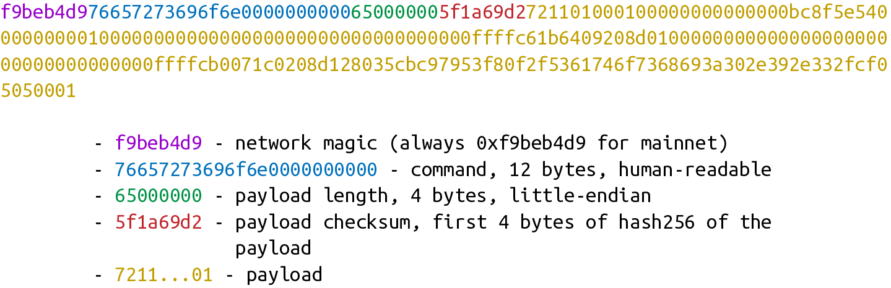
A message on the Bitcoin network
What a message looks like?
https://github.com/jimmysong/programmingbitcoin/blob/master/ch10.asciidoc

Slide 5
A message on the Bitcoin network
What a message looks like?
Magic (4 bytes):
Where message starts
If the connection fails
Identifies the network
0x0b110907 for testnet
https://github.com/jimmysong/programmingbitcoin/blob/master/ch10.asciidoc

Slide 6
A message on the Bitcoin network
What a message looks like?
Command (12 bytes):
e.g. 'block', 'header',…
ASCII string
https://en.bitcoin.it/wiki/Protocol_documentation
https://github.com/jimmysong/programmingbitcoin/blob/master/ch10.asciidoc

Slide 7
A message on the Bitcoin network
What a message looks like?
Length (4 bytes):
Little-endian!
https://github.com/jimmysong/programmingbitcoin/blob/master/ch10.asciidoc

Slide 8
A message on the Bitcoin network
What a message looks like?
Checksum (4 bytes):
Hash256(payload)[:4]
https://github.com/jimmysong/programmingbitcoin/blob/master/ch10.asciidoc

Slide 9
A message on the Bitcoin network
What a message looks like?
The meat!
https://github.com/jimmysong/programmingbitcoin/blob/master/ch10.asciidoc

Slide 10
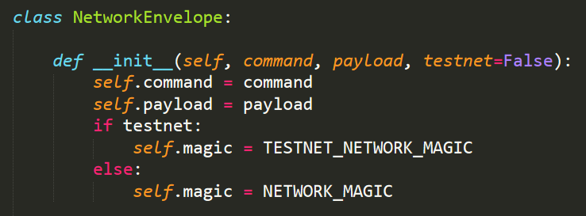
A message on the Bitcoin network
Implementation - class that stores the message

Slide 11
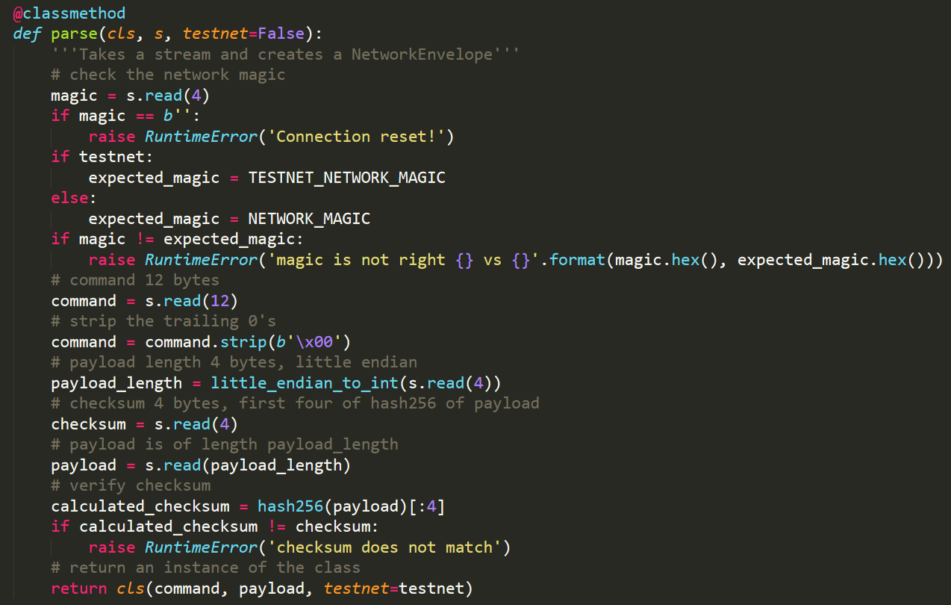
A message on the Bitcoin network
Implementation - class that stores the message

Slide 12
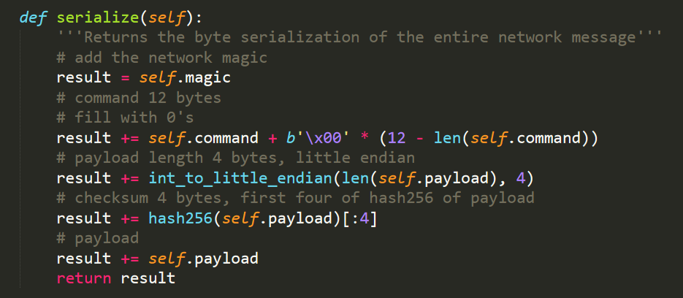
A message on the Bitcoin network
Implementation - class that stores the message

Slide 13
Bitcoin network
Some important commands
In this class we will implement:
Version
Verack
GetHeaders
Headers
In our implementation:
To send a message: we need serialize
To process a received message: we need parse

Slide 14
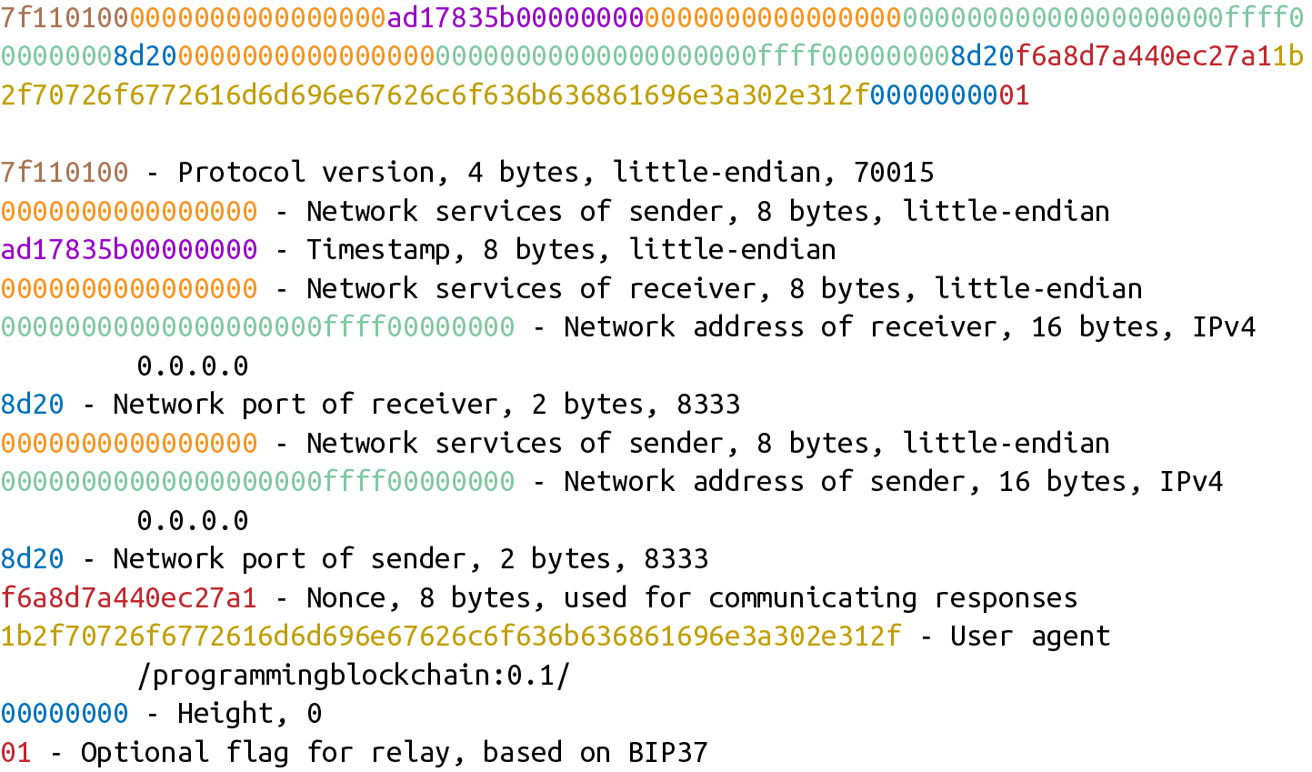
Bitcoin network
Version

Slide 15
Bitcoin network
Version serves to establish a connection between two nodes!
Version

Slide 16
Bitcoin network
What type of message can we interchange?
Version

Slide 17
Bitcoin network
What protocol does the node use (segWit, Litecoin, BCH)?
Version

Slide 18
Bitcoin network
What type of stuff do I need for this connection
Version

Slide 19
Bitcoin network
What is the time?
Serves to accept/reject blocks (and for other things)
Version

Slide 20
Bitcoin network
Address to which we send the messages
Version

Slide 21
Bitcoin network
Address of the node sending the message
Version

Slide 22
Bitcoin network
To detect if we are connecting to ourselves
Version

Slide 23
Bitcoin network
What software am I using? – var_str
Version

Slide 24
Bitcoin network
The last block that the node sending the message has!
Version

Slide 25
Bitcoin network
Bloom filters!
Version

Slide 26
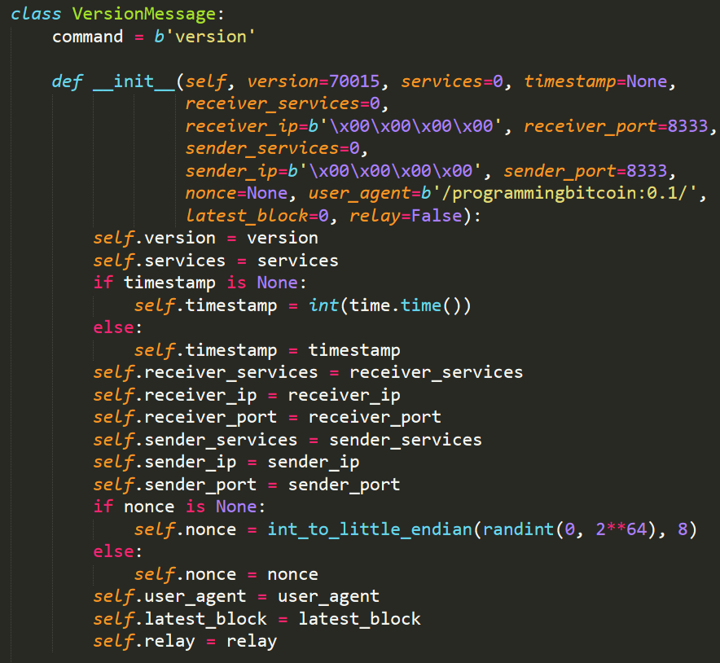
Bitcoin network
Version

Slide 27
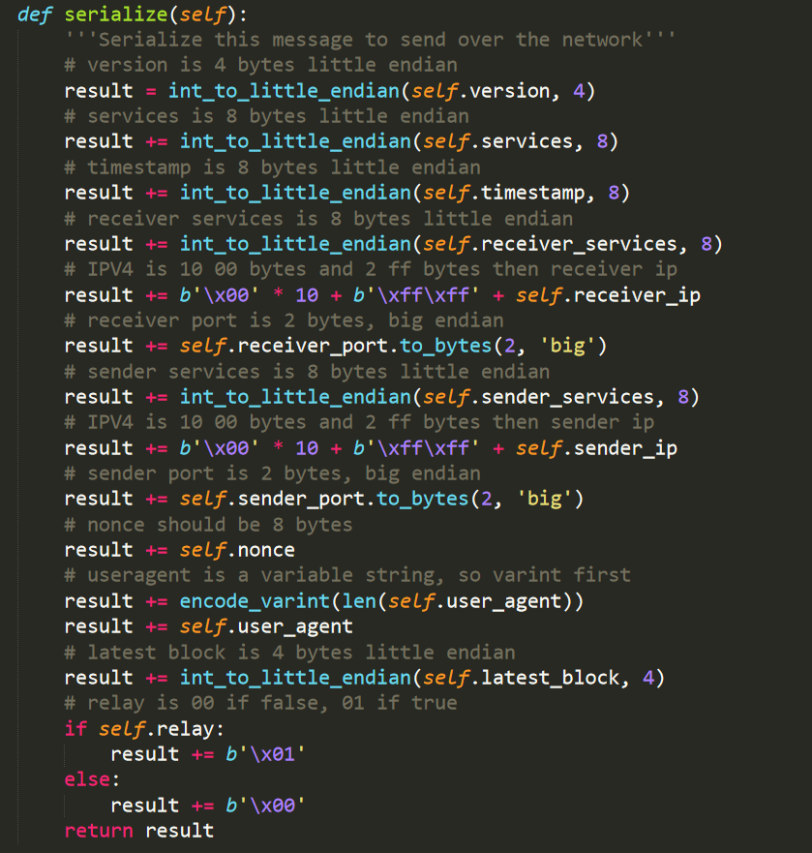
Bitcoin network
Version
We will only send!

Slide 28
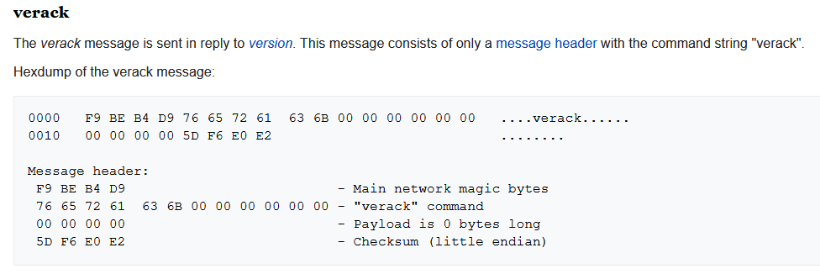
Bitcoin network
Verack
https://en.bitcoin.it/wiki/Protocol_documentation

Slide 29
Bitcoin network
Verack
I.e. "OK"
https://en.bitcoin.it/wiki/Protocol_documentation

Slide 30
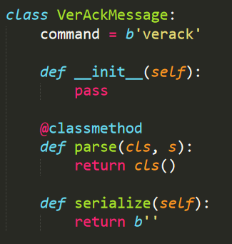
Bitcoin network
Verack

Slide 31
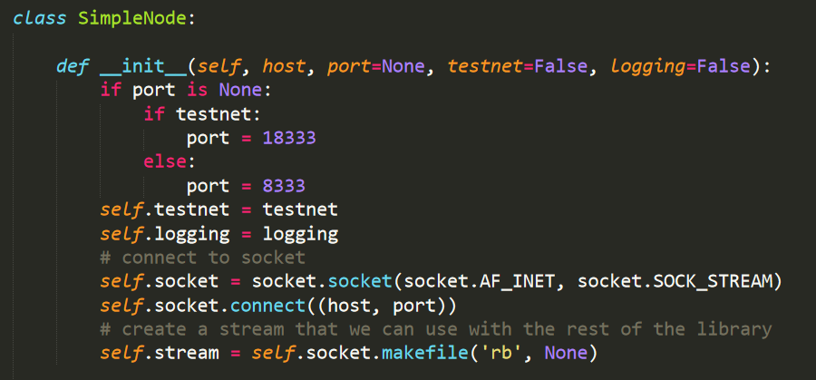
A simple node

Slide 32
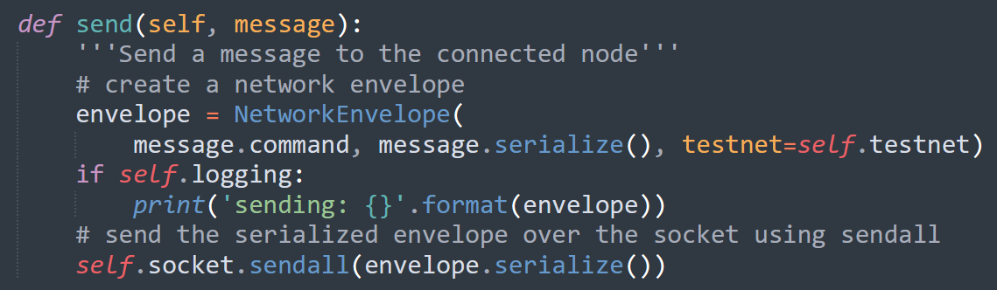
A simple node

Slide 33
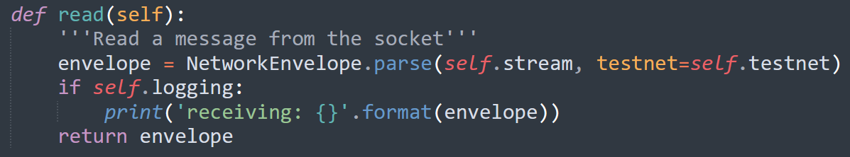
A simple node

Slide 34
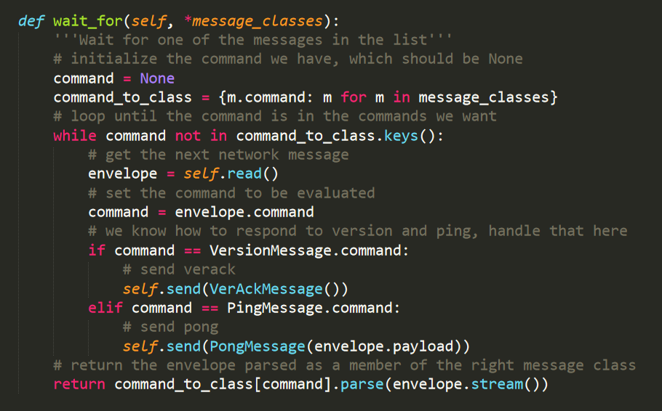
A simple node

Slide 35
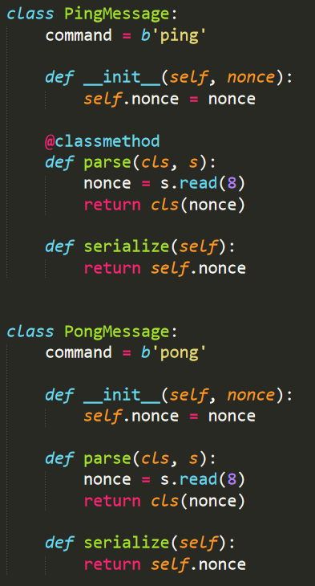
A simple node
Ping pong

Slide 36
A simple node
To simplify things, our implementation will be sinchronous!
(i.e. I send a message and wait for a reply)

Slide 37
A simple node

Slide 38
A simple node
To simplify things, our implementation will be sinchronous!
(i.e. I send a message and wait for a reply)

Slide 39
A simple node
To simplify things, our implementation will be sinchronous!
(i.e. I send a message and wait for a reply)
Real nodes communicate in asynchronous manner!

Slide 40
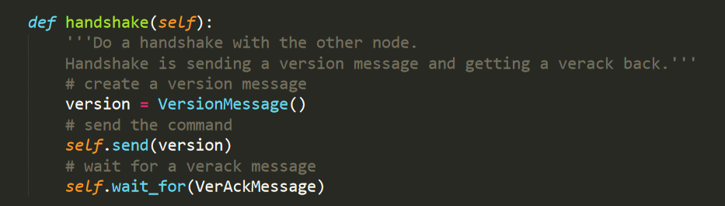
A simple node

Slide 41
A simple node
This is how we start

Slide 42
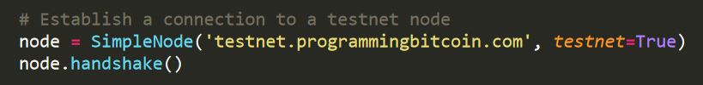
A simple node
Initial connection
I need to know the address of at lesat one node!

Slide 43
Bitcoin network
SPV nodes
If I am an SPV node, I need the blockchain of headers!
Version
Verack
GetHeaders
Headers

Slide 44
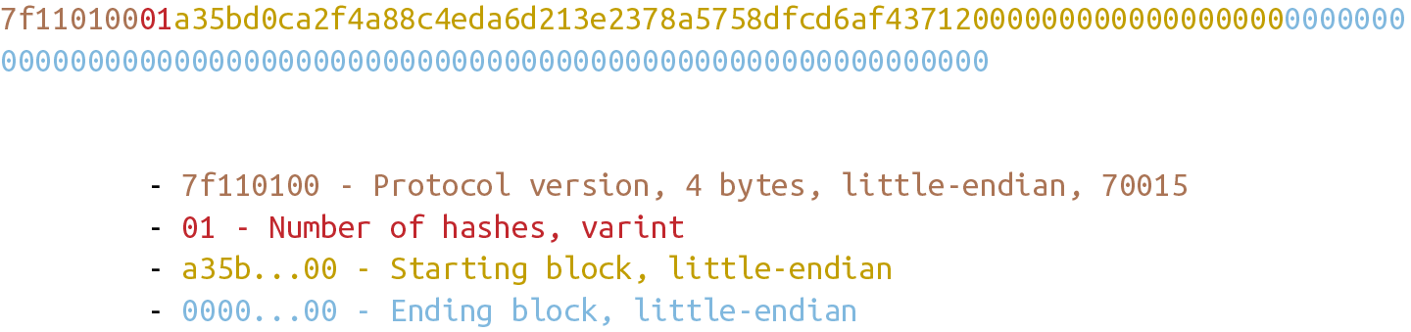
Bitcoin network
GetHeaders
With getheaders I can obtain headers (max 2000!)
Payload:

Slide 45
Bitcoin network
GetHeaders
In reality, I can start from multiple blocks (e.g. for forks)
With getheaders I can obtain headers (max 2000!)
Payload:

Slide 46
Bitcoin network
GetHeaders
If this is 0, we should receive
up to the next 2000 blocks
With getheaders I can obtain headers (max 2000!)
Payload:
Depends on the node we connect to!

Slide 47
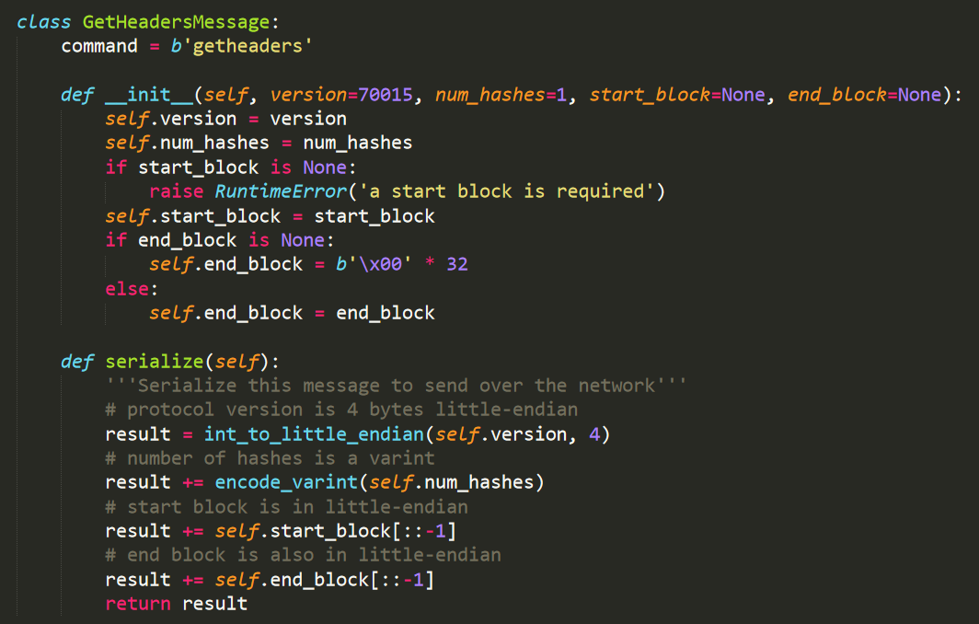
Bitcoin network
GetHeaders

Slide 48
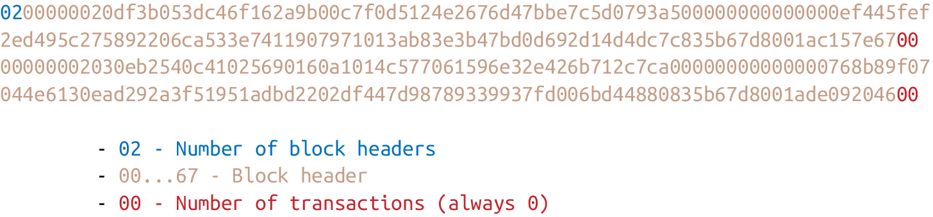
Bitcoin network
headers
Reply to getheaders is headers
Payload:

Slide 49
Bitcoin network
headers
We have to parse this!!!
Reply to getheaders is headers
Payload:

Slide 50
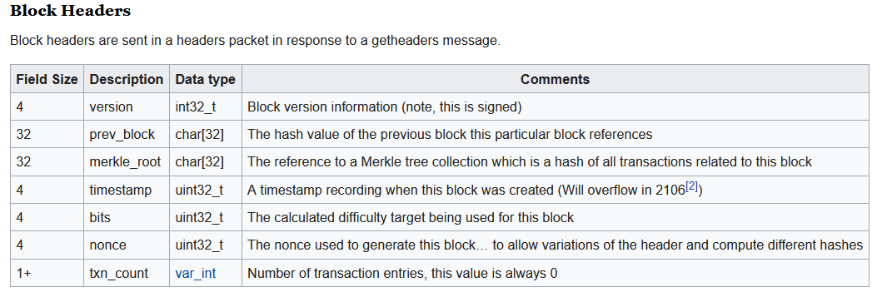
Block headers
https://en.bitcoin.it/wiki/Protocol_documentation

Slide 51
Block headers
Our implementation checks this in the payload of the header message!
https://en.bitcoin.it/wiki/Protocol_documentation

Slide 52
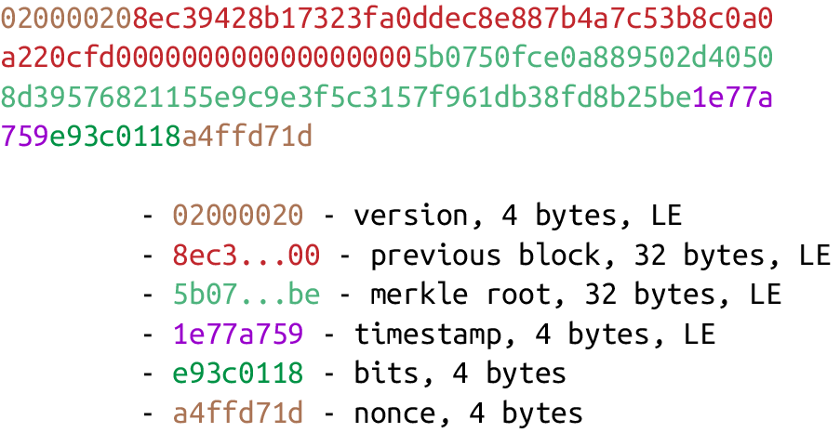
Block headers
In bytes
https://github.com/jimmysong/programmingbitcoin/blob/master/ch09.asciidoc

Slide 53
Block headers
In bytes
https://github.com/jimmysong/programmingbitcoin/blob/master/ch09.asciidoc

Slide 54
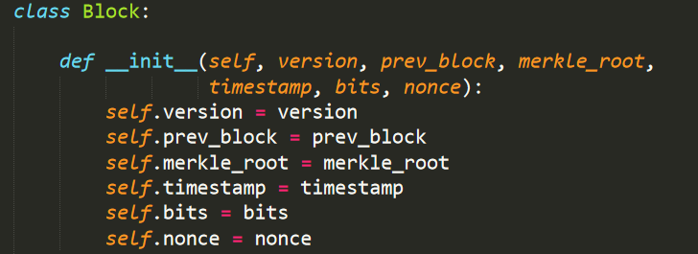
Block headers
In Python
https://github.com/jimmysong/programmingbitcoin/blob/master/ch09.asciidoc

Slide 55
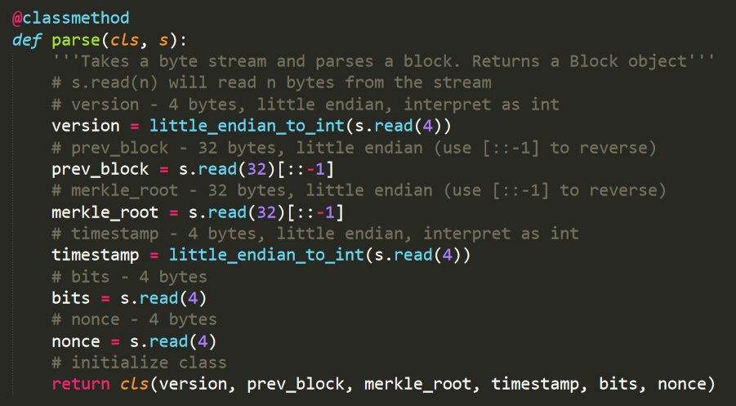
Block headers
In Python
https://github.com/jimmysong/programmingbitcoin/blob/master/ch09.asciidoc

Slide 56
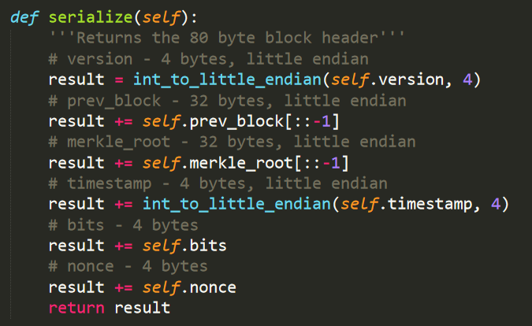
Block headers
In Python
https://github.com/jimmysong/programmingbitcoin/blob/master/ch09.asciidoc

Slide 57
Bitcoin network
headers
Now we know how to
parse this part!!!
Reply to getheaders is headers
Payload:

Slide 58
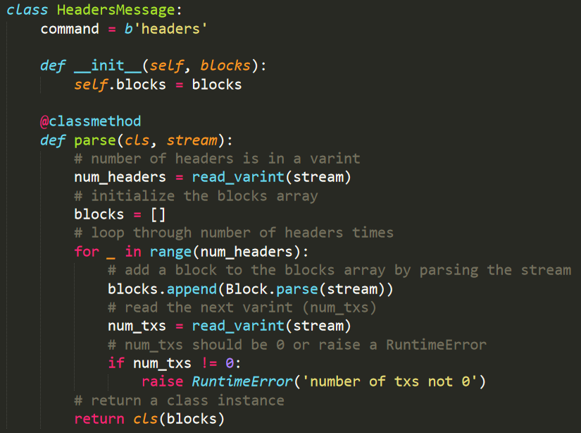
Block headers
We will get headers message

Slide 59
Block headers
We will get headers message
Blockchain of headers

Slide 60
Block headers
We will get headers message
Number of headers

Slide 61
Block headers
We will get headers message
Headers (we will store this as objects of the class block)

Slide 62
Block headers
We will get headers message
Number of transactions needs to be 0 (for a header)!

Slide 63
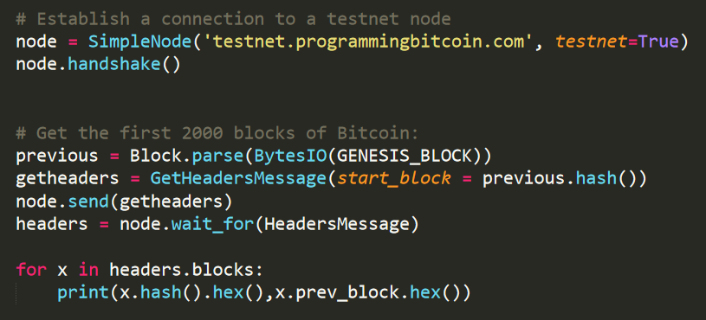
Block headers
How to get the first 2000 blocks?

Slide 64
Block headers
How to get the first 2000 blocks?
We need the genesis block!

Slide 65
Block headers
How to get the first 2000 blocks?
Ask for blocks!

Slide 66
Block headers
How to get the first 2000 blocks?
Wait to recieve the blocks

Slide 67
Proof of work
Allos to check if POW is valid!
(do not confuse with bits of a Merkle tree)

Slide 68
Proof of work
How to check that POW of a block is valid?
hash(header) < target
bits are correct (according to the difficulty adjustment)

Slide 69
Proof of work
How to check that POW of a block is valid?
hash(header) < target
bits are correct (according to the difficulty adjustment)
To compute the hash of a block
I only need the header
(it conatins the MerkleRoot)

Slide 70
Proof of work
How to check that POW of a block is valid?
hash(header) < target
bits are correct (according to the difficulty adjustment)
Difficulty adjustment is deterministic!
All the nodes can check it!
Here we use the timestamp of a block!

Slide 71
Proof of work
How to check that POW of a block is valid?
hash(header) < target
bits are correct (according to the difficulty adjustment)
Target is computed using bits
(the ones from the block header)

Slide 72
Proof of work
Target
How to compute target?
Using bits = 4 bytes
bits are two different numbers:
Byte 4 is the exponent: exp
Bytes 1,2,3 are the coefficient: coeff (in Little-endian)
target = coeff ⋅ 256^{exp-3}

Slide 73
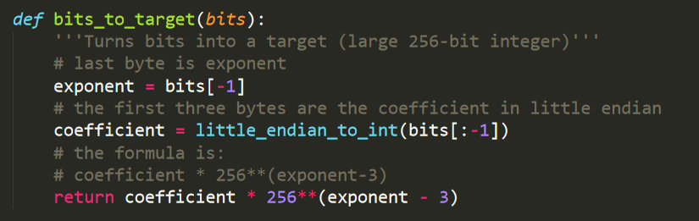
Proof of work
Target
target = coeff ⋅ 256^{exp-3}
Function implemented in helper.py

Slide 74
Proof of work
How to check that POW of a block is valid?
hash(header) < target
bits are correct (according to the difficulty adjustment)

Slide 75
Proof of work

Slide 76
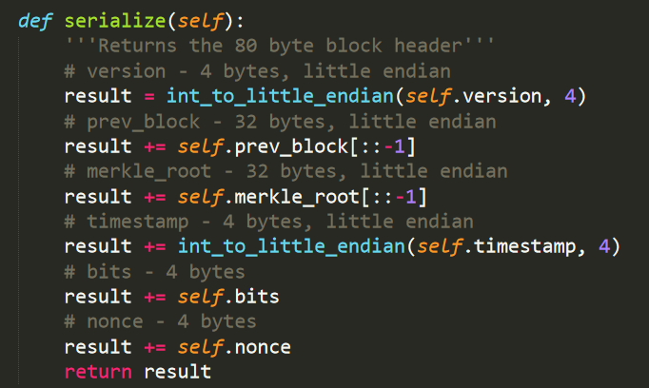
Proof of work
Block header already has everything needed!!!

Slide 77
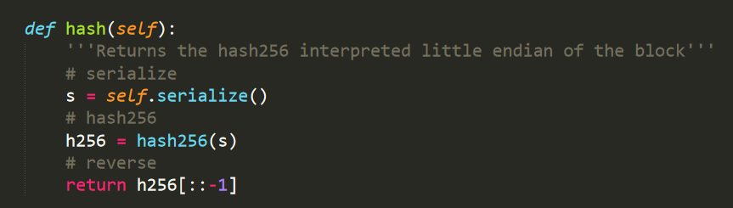
Proof of work

Slide 78
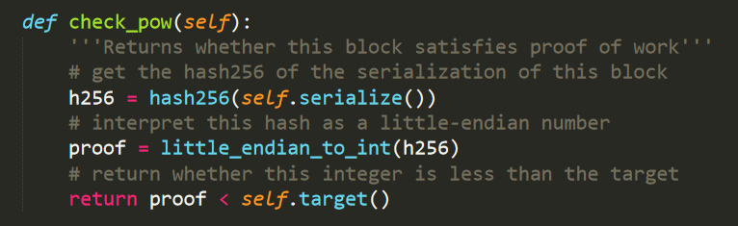
Proof of work

Slide 79
Proof of work
How to check that POW of a block is valid?
hash(header) < target
bits are correct (according to the difficulty adjustment)
Are we solving the correct puzzle?

Slide 80
Proof of work
Difficulty adjustment
bits are correct (according the difficulty adjustment)
Each group of 2016 blocks in Bitcoin is called difficulty adjustment period
Target is adjusted according to the formula:
time_diff = (timestamp of the last block) – (timestamp of the first block)
new_target = prev_target ⋅time_diff/(2 weeks)

Slide 81
Proof of work
E.g. for the period of blocks: 2017 until 4032
new_target is computed using the difference between blocks 2016 and 1
Difficulty adjustment
bits are correct (according the difficulty adjustment)
Each group of 2016 blocks in Bitcoin is called difficulty adjustment period
Target is adjusted according to the formula:
time_diff = (timestamp of the last block) – (timestamp of the first block)
new_target = prev_target ⋅time_diff/(2 weeks)

Slide 82
Proof of work
E.g. for the period of blocks: 2017 until 4032
This is the target fo the period 1 - 2016
Difficulty adjustment
bits are correct (according the difficulty adjustment)
Each group of 2016 blocks in Bitcoin is called difficulty adjustment period
Target is adjusted according to the formula:
time_diff = (timestamp of the last block) – (timestamp of the first block)
new_target = prev_target ⋅time_diff/(2 weeks)

Slide 83
Proof of work
Remark:
If time_diff>8 weeks we will use 8 weeks
If time_diff<3.5 days we will use 3.5 days
Difficulty adjustment
bits are correct (according the difficulty adjustment)
Each group of 2016 blocks in Bitcoin is called difficulty adjustment period
Target is adjusted according to the formula:
time_diff = (timestamp of the last block) – (timestamp of the first block)
new_target = prev_target ⋅time_diff/(2 weeks)

Slide 84
Proof of work
Remark:
Another one-off bug from Satoshi: the difference is between 2015 blocks, so not precisely 2 weeks!
Difficulty adjustment
bits are correct (according the difficulty adjustment)
Each group of 2016 blocks in Bitcoin is called difficulty adjustment period
Target is adjusted according to the formula:
time_diff = (timestamp of the last block) – (timestamp of the first block)
new_target = prev_target ⋅time_diff/(2 weeks)

Slide 85
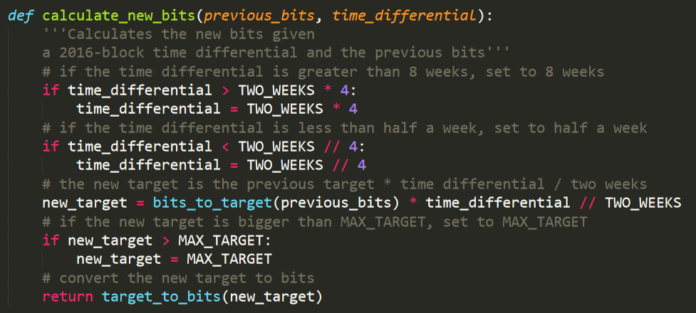
Proof of work
Difficulty adjustment
Function implemented in helper.py

Slide 86
Proof of work
Target of the genesys block; it can never be lower than this!
Difficulty adjustment
Function implemented in helper.py

Slide 87
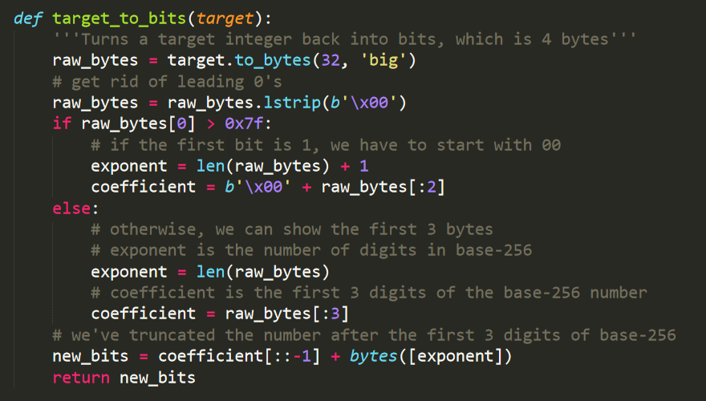
Proof of work
Difficulty adjustment
Function implemented in helper.py

Slide 88
Proof of work
With this, our implementation can download the block headers, and verify that they all satisfy the proof-of-work for this block!
As an exercise, you can use our implementation to verify this!

Slide 89
References
You can read more in:
Programming Bitcoin, chapters 9,10
https://en.bitcoin.it/wiki/Protocol_documentation

